Slide 1
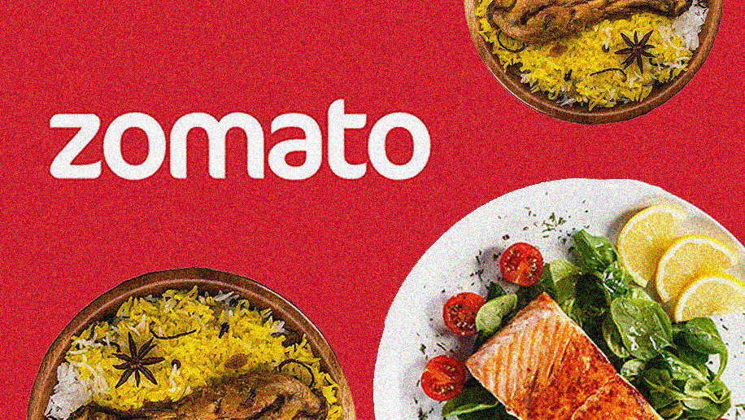
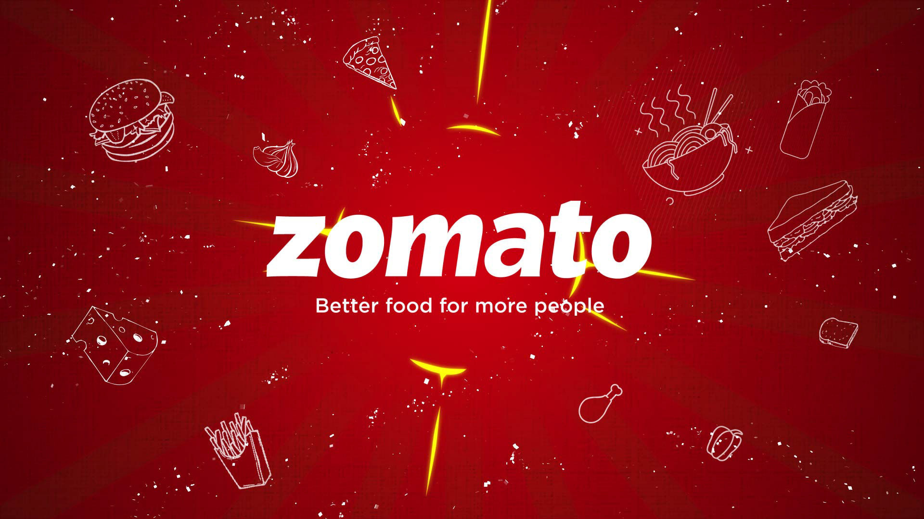

Zomato, Bangalore Data Analysis
What and where to eat in Bangalore….

Slide 2
Preface about DATASET
Bangalore has a unique food culture. Restaurants from all over the world can be found here in Bengaluru, with various kind of cuisines. Some might even say that Bangalore is the best place for foodies. The food industry is always at a rise in Bangalore, with 12,000 plus restaurants currently active in the city, the number is still increasing.
The growing number of restaurants and dishes in Bangalore is what attracts me to inspect the data to get some insights, some interesting facts and figures. So, in this project I will be analyzing the Zomato restaurant data for the city, Bangalore in MySQL workbench.

Slide 3
Attributes of the Dataset
The dataset is taken from Kaggle. It contains the following features :
name : This feature contains the name of the restaurant
online_order : whether online ordering is available in the restaurant or not
book_table : table book option available or not
rate : contains the overall rating of the restaurant out of 5
votes : contains total number of upvotes for the restaurant
rest_type : restaurant type
dish_liked : dishes people liked in the restaurant
cuisines : food styles, separated by comma
avg_cost: contains the approximate cost of meal for two people
meal_type : type of meal
city: contains the neighborhood in which the restaurant is located
The dataset contains 19118 rows.

Slide 4
BUSINESS INSIGHTS FROM THE DATASET
After cleaning the data of null values and blank rows we have the following business insights from the dataset…

Slide 5
No. of restaurants having the option for online ordering
Majority of the restaurants(13,933 out of 19118) have the option for booking online.
Restaurants having option for online ordering is - 13,933 ie 72.88%
Restaurants not having option for online ordering is - 5,185 ie 27.12%

Slide 6
No. of restaurants having the option to book a table
We see that very high number of restaurants does not offer the service to book table, and very less do.
This means that people at Bangalore prefer to eat at their homes or prefer fast food(snacks — quick bites).
Only 4203 out of 19118 restaurants have the option of booking a table

Slide 7
No. of restaurants in each city
BTM has the highest number of restaurants, followed by Koramangala 7th Block.
New BEL Road has the least number of restaurants, followed by Banashankari.
It seems that the main foodies live in BTM and Koramangala.

Slide 8
No. of restaurants for each rating
The majority of restaurants (3016) are rated 3.9(out of 5), followed by 4 and 4.1, which are decent ratings. This means that most of the restaurants at Bangalore are liked by the citizens and hence rated above average.
No. of restauranats rated 4 are 2631 and those rated 4.1 are 2468.
There are very few restaurants with very high rating like 4.9 or 4.8.
Also, there are very less number of restaurants that are rated below average.
This shows that due to high rise in the number of restaurants in Bangalore, the competition is at its best, as every restaurant is trying to excel in quality and services to increase the number of customers, and hence enhance profit.

Slide 9

No. of restaurants for each rating

Slide 10
Top 10 types of restaurant which have the highest no. of restaurant
We see that, the most number of restaurants are of the type Casual Dining.
From the given plot it is clear that people at Bangalore prefer ‘casual dining’ and ‘quick bites’ more often
Followed by café and Dessert parlour.

Slide 11
10 types which have the least number of restaurants
Here, we see that there is only one restaurant of type ‘Dhaba’ followed by ‘food court, casual dining’.
There are also very few bar, microbrewery, club and lounge in the city of Bangalore.

Slide 12
Number of restaurants for different average costs
We see that the majority of restaurants in Bangalore have the average cost(for two) 400, followed by 600 and 800.
This means that the competition is very high as far as the less costly restaurants are considered.
The expensive ones in the range of 3000 to 5000 are very few in numbers.

Slide 13
Top 10 cuisines that are offered by the maximum number of restaurants.
We see that North Indian cuisine is offered by most number of restaurants.
This is worth discussing, as Bangalore is situated in South India and yet people there prefer to eat North Indian cuisine.
This can be due to the fact, that people from all sorts of backgrounds reside in Bangalore, hence we can see North Indian and Chinese served by more number of restaurants than South Indian. Also, many Indians prefer to eat Chinese.

Slide 14
Top 50 rated vs 50 least rated restaurants
50 Top rated
50 Least rated

Slide 15
Top 50 rated vs 50 least rated restaurants
Top 50 rated
50 least rated
Byg Brewski Brewing Company restaurant has the maximum number of upvotes(16,000+), then we have Toit with around 15,000 upvotes, followed by The Black Pearl which has around 10,500 upvotes.
There is a sharp decrease in number of votes when moving from 2nd to 3rd positioned restaurant. no restaurant(or chain of restaurants) is rated 5 out of 5, however we have few who are rated 4.9.
Asia Kitchen by Mainland China, Belgian Waffle, Byg Brewski Brewing Company and Santa A spa cuisines are top rated restaurants with a rating of 4.9 out of 5.
Further we have so many restaurants that are rated above 4.0, which is a good thing as this indicates that the quality of food is increasing in Bangalore.
Fusion Lounge is least rated i.e 2.0, followed by Mama Mexicana and Decker’s Lane.
Fusion Lounge on Brigade road is a dance floor, dj type of restaurant and dish liked is Finger food which is not on the top of dishes liked by the people. Average cost for two is which is quite expensive keeping in mind their services, which is not upto the mark.
Their average rating is between 2.0 to 2.5.
We have few number of restaurants that have low rating, in Bangalore.

Slide 16
Top restaurant - Byg Brewski Brewing Company restaurant
This restaurant has outstanding rating, 4.9 out of 5.0.
The restaurant is a Microbrewery type of restaurant, and offers the above mentioned cuisines. The dishes liked by the people are also mentioned.
The meal type for different branches of the restaurant include Delivery, Dine-out and Drinks & nightlife, this means that Byg Brewski Brewing Company restaurant is one of those strong competitors in these types of meals.
This restaurant is a bit costly, with the average cost(for two people) 1600 but when compared to normal pubs and bars then it seems to be a little cheaper, also the ratings and upvotes show that it is worthy.
name | Byg Brewski Brewing Company | Byg Brewski Brewing Company | Byg Brewski Brewing Company
online_order | Yes | Yes | Yes
book_table | Yes | Yes | Yes
rate | 4.9/5 | 4.9/5 | 4.9 /5
votes | 16345 | 16345 | 16832
rest_type | Microbrewery | Microbrewery | Microbrewery
dish_liked | Cocktails, Dahi Kebab, Rajma Chawal, Butter Chicken, Craft Beer, Chicken Dumplings, Teriyaki Fish | Cocktails, Dahi Kebab, Rajma Chawal, Butter Chicken, Craft Beer, Chicken Dumplings, Teriyaki Fish | Cocktails, Butter Chicken, Dahi Kebab, Rajma Chawal, Craft Beer, Teriyaki Fish, Buffalo Wings
cuisines | Continental, North Indian, Italian, South Indian, Finger Food | Continental, North Indian, Italian, South Indian, Finger Food | Continental, North Indian, Italian, South Indian, Finger Food
approx_cost(for two people) | 1,600 | 1,600 | 1,600

Slide 17
Which city is costlier in terms of food, and which are not with respect to average cost for each city?
The average cost(for two) for restaurants is highest in Church Street(550), followed by Lavelle Road, Residency Road(500) and Brigade Road(500).
For most of the cities the average cost is 400.
Banashankari has the lowest average cost, equal to 300.

Slide 18
Which city has the highest number of restaurants with high ratings?
The average rating of restaurants in Brigade Road(3.9), Church Street(3.9) and MG Road(3.9) is highest, followed by Koramangala 4th Block(3.8), and Lavelle Road(3.8) .
Electronic City(3.5), however has the lowest number of restaurants with good ratings.
The difference between Brigade Road and Electronic City is not much,and so we conclude that all cities have, on an average, great restaurants.

Slide 19
Top 10 dishes liked by the citizens of Bangalore
We see that people at Bangalore love Biryani the most(and why not its so delicious!!), then Waffles followed by Masal Dosa and then Chicken Biryani and then.
Out of these Biryani accounts for the most(30%) liked dish by the people of Bangalore.

Slide 20
Top restaurants serving Most liked dish 'Biryani' , along with their ratings and average cost
Restaurant vs rating
Restaurant vs average cost for two

Slide 21
Top restaurants serving Most liked dish 'Biryani' , along with their ratings and average cost
From the graphs it is evident that Bhairaveshwara Military Hotel with a rating of 4.2 serves the most liked dish ‘Biryani’ to the people of Bnagalore.
Then comes eat.fir followed by Andhra Biryani and Andhra Kitchens which provides one of the best qualities biryanis in Bangalore.
All of these restauranted are rate 4.0 and above with an average cost of 250-400 which is quite budget friendly for the people.
That’s the reason why the people of Bangalore love their Biryani the most as it within a affordable range not very expensive.

Slide 22


Conclusion
The Zomato dataset was analyzed to gain some insights of the food industry and food culture in Bangalore.
We deduce some great results like which city has the most number of restaurants and hence highest number of foodies, we also saw that which city has high number of well-rated restaurants, what all cuisines are mostly preferred by people etc.
We even found ourselves some great restaurants and some not so great ones also.

Slide 23
Thank You!!
Designed and edited by – Sreya Basak

